Slide 1

Privacy drifters
Privacy Visualization of decentralized riding-pool platform

Slide 2
Content
Problem Description
Our Approach
Our Results

Slide 3

Problem Description

Slide 4



ride-Pooling Platforms
People searches rides from A to B
Riders offer rides from A to B
Riding-Pool Platform matches those people searching and offering rides
Ride between two persons are confirmed with smart contracts

Slide 5
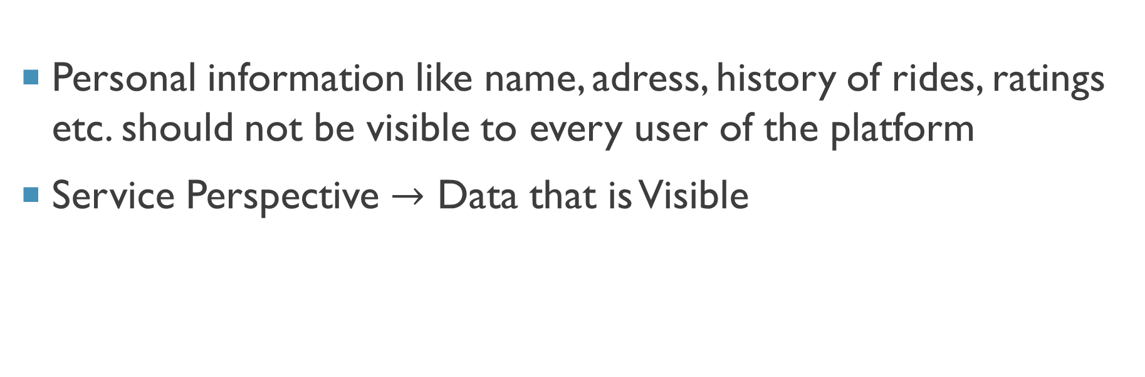
Privacy visualization of riding-pool Platform
Personal information like name, adress, history of rides, ratings etc. should not be visible to every user of the platform
Service Perspective $→$ Data that is Visible

Slide 6




From Riding request to smart contract
Auth-Service
Blockchain
Token Request
Matching Service
Smart Contract
Token
Matching Service
Auth-Service
Smart Contract
Notes:
Before requesting or offering a ride, a user must go through an Authentification Service
The Authentification Service owns master data of the users like: personal information, the users history of rides, the users rating
User registers with help of Authentification Service
Authentification Service allows to access the Ratings of the persons
Authentification Service is API Interface for Matching Service

Slide 7

From Riding request to smart contract
Blockchain
Token Request
Auth-Service
Smart Contract
Smart Contract
Token
Matching Service
Smart Contract
Matching Service
Matching Service
Matching Service
Auth-Service
Smart Contract
Smart Contract
Smart Contract
Notes:
Before requesting or offering a ride, a user must go through an Authentification Service
The Authentification Service owns master data of the users like: personal information, the users history of rides, the users rating
User registers with help of Authentification Service
Authentification Service allows to access the Ratings of the persons
Authentification Service is API Interface for Matching Service

Slide 8
Conceptual approach
Visualize private data according to different perspectives:
Auth.-
Service
Matching Service
Smart Contract

Slide 9
Research question
How to visualize data privacy within a ride-pooling platform?

Slide 10

Our Approach

Slide 11
Technological approach
Brainstorming about how to visualize data privacy on that platform
Obstacles :
Creating a map and having an interactive H3 Grid.
Frontend:
Single Page or Multipage ?
React v/s Vue ?
Backend:
Connect Blockchain data to MongoDB Cluster

Slide 12
From Riding request to smart contract
Auth-Service
Blockchain
Matching Service
Smart Contract
Matching Service
Smart Contract
Matching Service
Auth-Service
Smart Contract
Notes:
Pfeile in doppelrichtugn
Matching service

Slide 13
From Riding request to smart contract
Blockchain
Token Request
Auth-Service
Matching Service
Smart Contract
Use Token
Create Smart Contract
Notes:
Before requesting or offering a ride, a user must go through an Authentification Service
The Authentification Service owns master data of the users like: personal information, the users history of rides, the users rating
User registers with help of Authentification Service
Authentification Service allows to access the Ratings of the persons
Authentification Service is API Interface for Matching Service

Slide 14
From Riding request to smart contract
Blockchain
Token Request
Auth-Service
Matching Service
Notes:
Before requesting or offering a ride, a user must go through an Authentification Service
The Authentification Service owns master data of the users like: personal information, the users history of rides, the users rating
User registers with help of Authentification Service
Authentification Service allows to access the Ratings of the persons
Authentification Service is API Interface for Matching Service

Slide 15
From Riding request to smart contract
Blockchain
Auth-Service
Token
Matching Service
Use Token
Notes:
Before requesting or offering a ride, a user must go through an Authentification Service
The Authentification Service owns master data of the users like: personal information, the users history of rides, the users rating
User registers with help of Authentification Service
Authentification Service allows to access the Ratings of the persons
Authentification Service is API Interface for Matching Service

Slide 16
From Riding request to smart contract
Blockchain
Auth-Service
Matching Service
Smart Contract
Create Smart Contract
Notes:
Before requesting or offering a ride, a user must go through an Authentification Service
The Authentification Service owns master data of the users like: personal information, the users history of rides, the users rating
User registers with help of Authentification Service
Authentification Service allows to access the Ratings of the persons
Authentification Service is API Interface for Matching Service

Slide 17
From Riding request to smart contract
Blockchain
Auth-Service
Matching Service
Smart Contract
Confirm Ride
Notes:
Before requesting or offering a ride, a user must go through an Authentification Service
The Authentification Service owns master data of the users like: personal information, the users history of rides, the users rating
User registers with help of Authentification Service
Authentification Service allows to access the Ratings of the persons
Authentification Service is API Interface for Matching Service

Slide 18
From Riding request to smart contract
Auth-Service
Blockchain
Token Request
Matching Service
Smart Contract
Token
Matching Service
Smart Contract
Matching Service
Auth-Service
Smart Contract
Notes:
Before requesting or offering a ride, a user must go through an Authentification Service
The Authentification Service owns master data of the users like: personal information, the users history of rides, the users rating
User registers with help of Authentification Service
Authentification Service allows to access the Ratings of the persons
Authentification Service is API Interface for Matching Service

Slide 19

Results

Slide 20
Authentification service View
Authentification-Service
Master Data
Ratings
Past Wallets (allows to access blockchain)
History of pseudonyms, smart contracts of one person
(Ride Providers, Matching Services, People)
Notes:
Registrierung
Einloggen
Zuordnung der Ratings in den Smart Contracts
Hat eigenen Speicher und in denen sind die Master Data und die Pseudonyme verlinkt

Slide 21
Matching Service View
Matching-Service
Grid
People
Ride Providers
Starting Points
End Points
Area

Slide 22
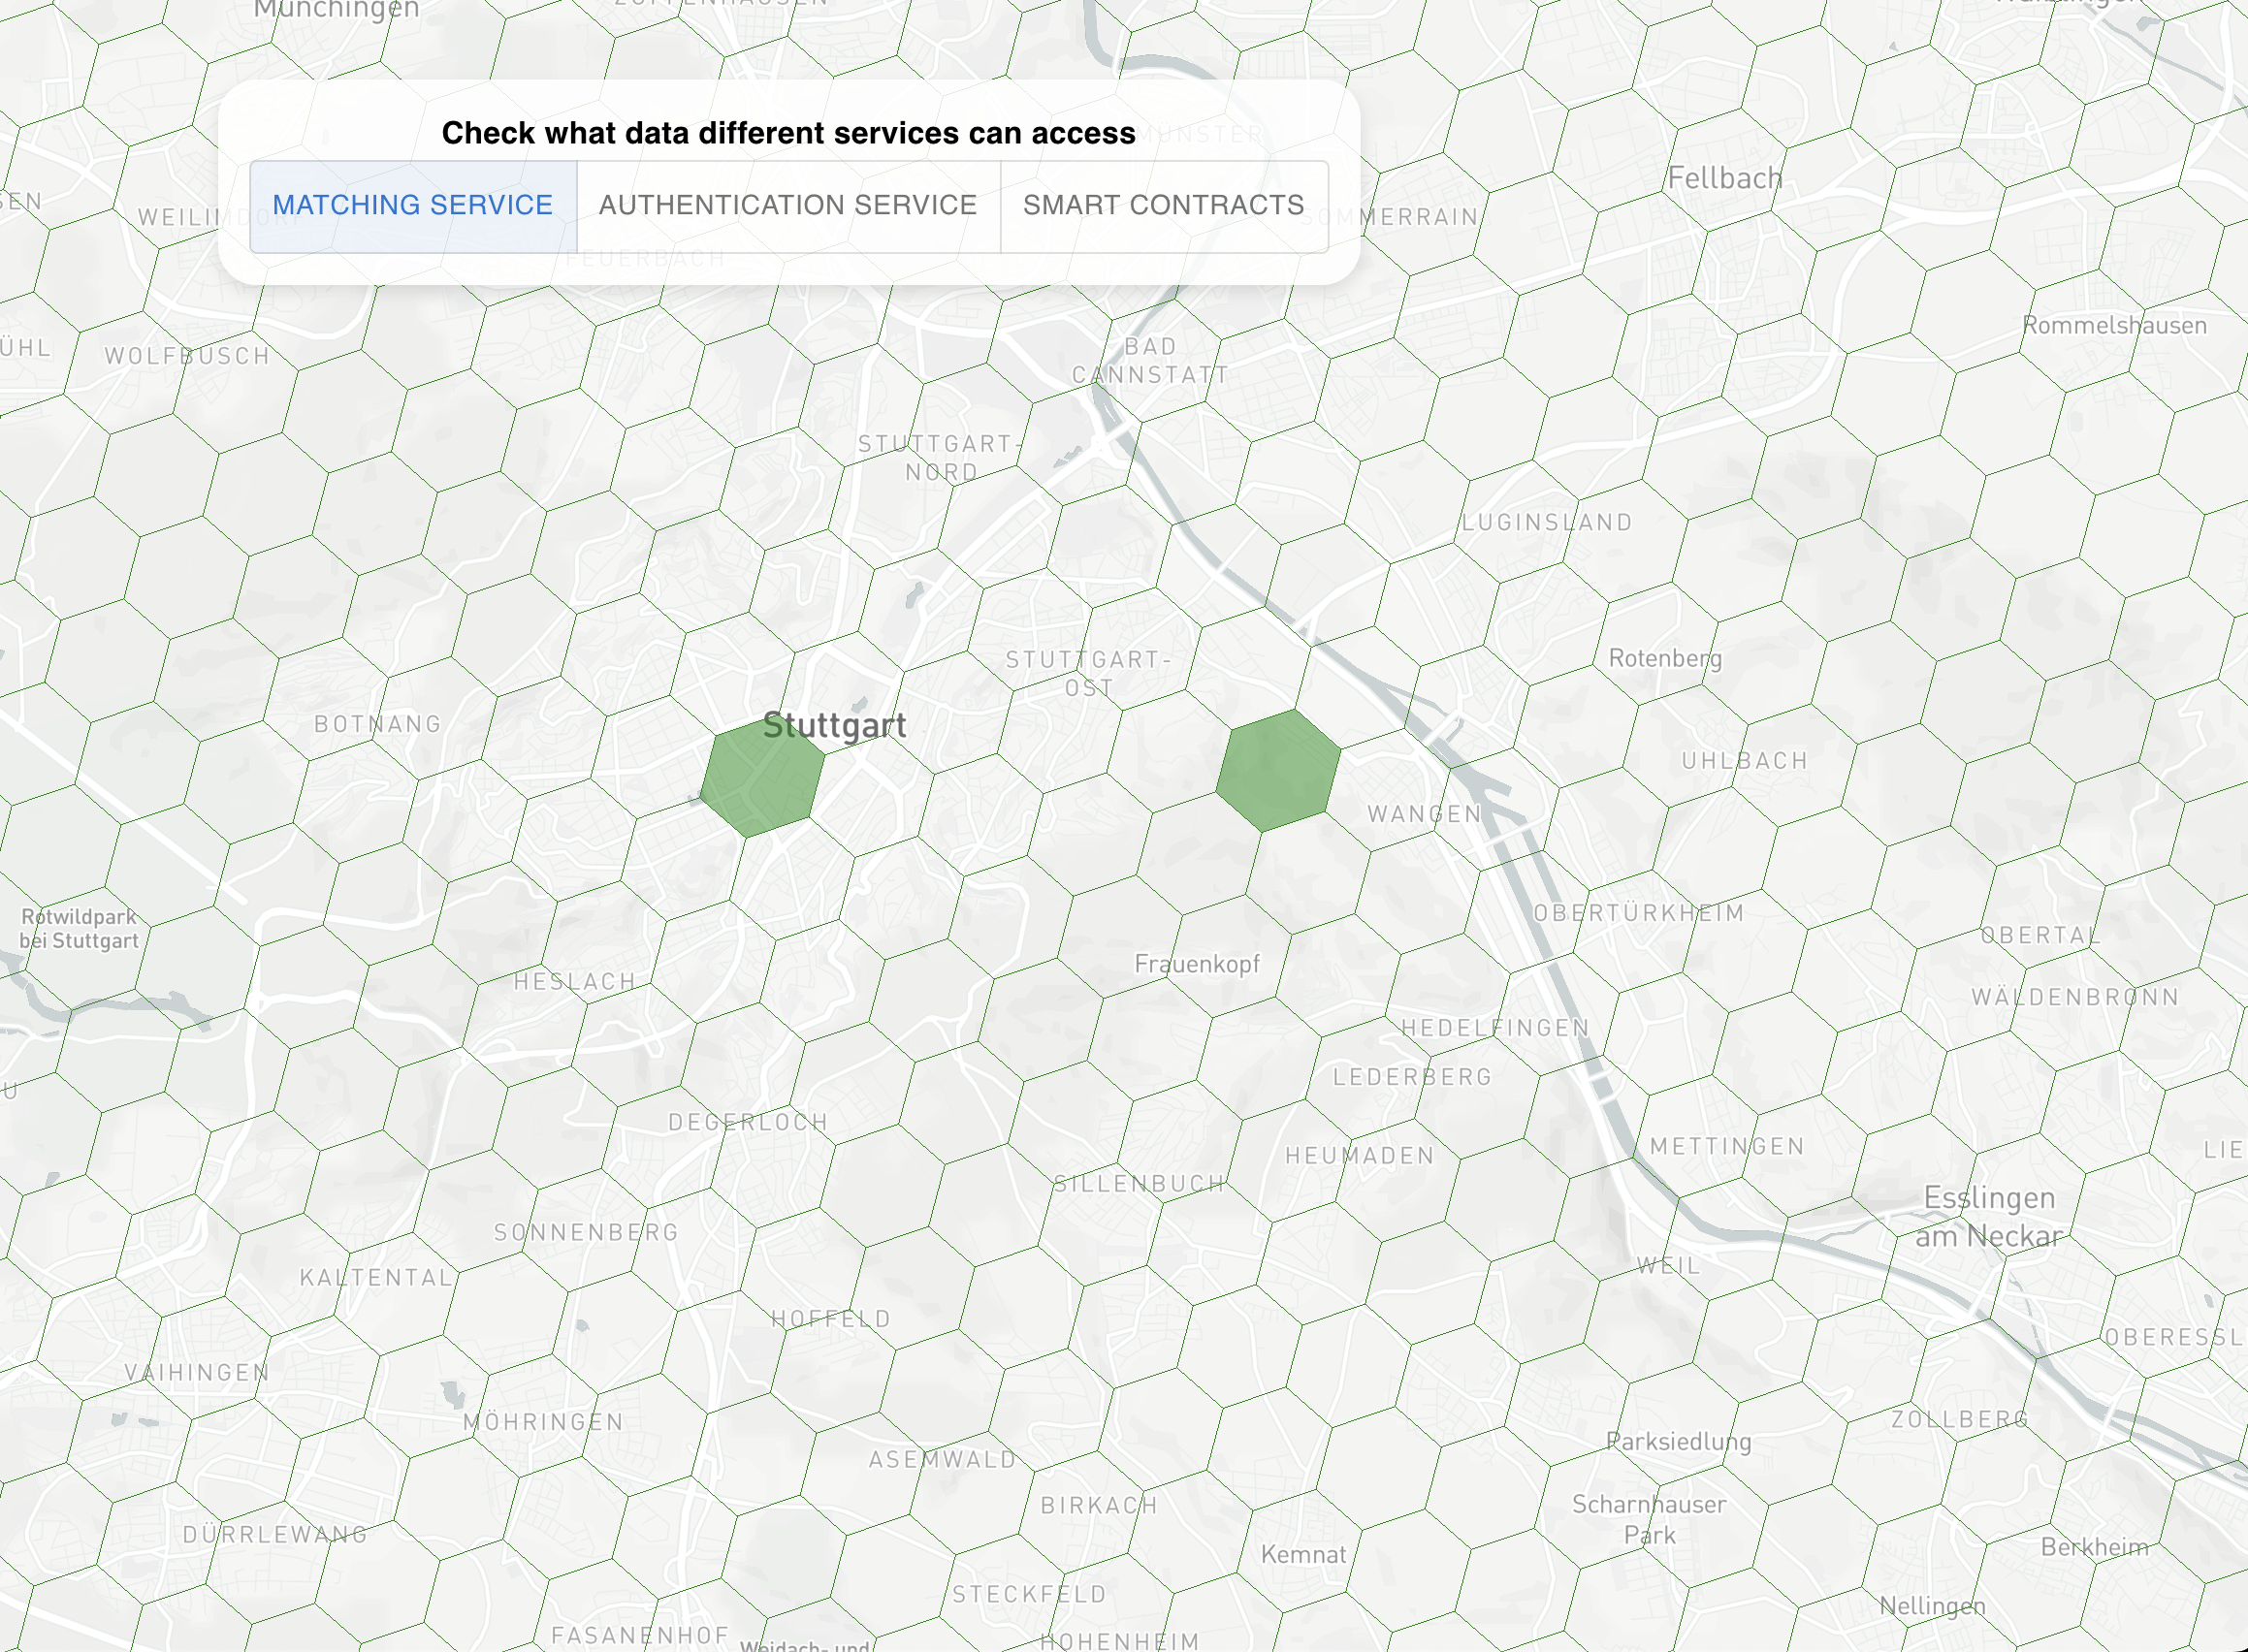

Slide 23
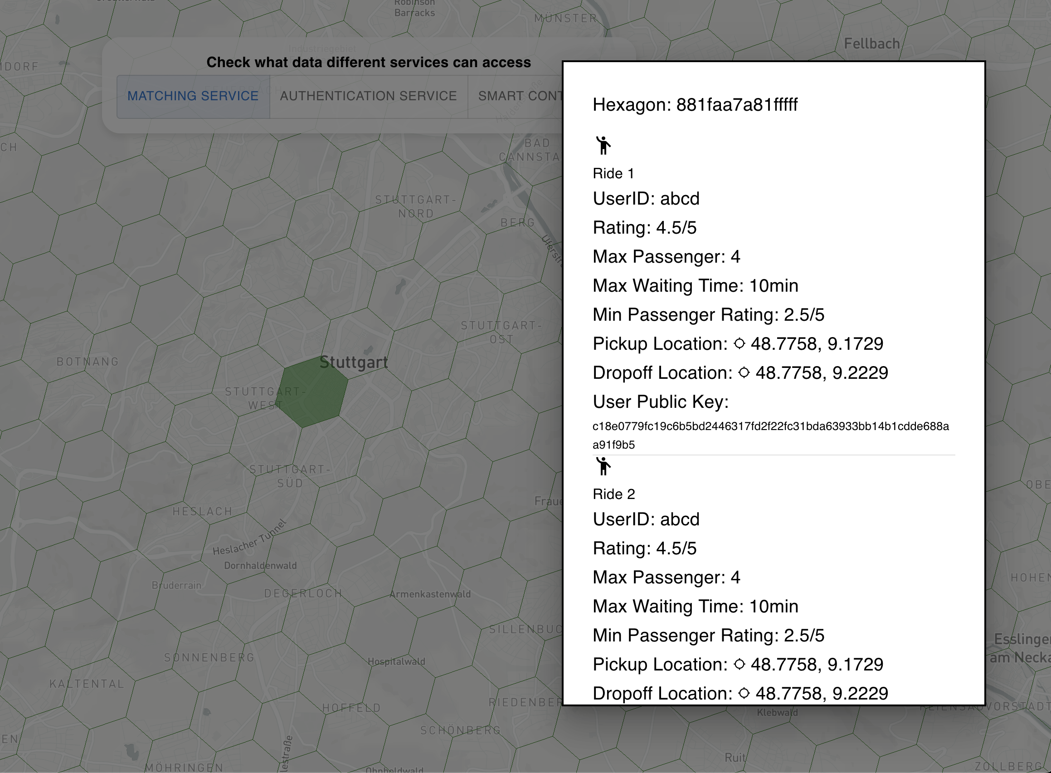

Slide 24
Smart contract Service View
Smart Contract Service
Ride (hidden details)
Ratings of people

Slide 25

Thank you
Privacy drifters

